Slide 1
Computer Graphics HW4 : 3D Maze
Deadline: May 23, 2021

Slide 2
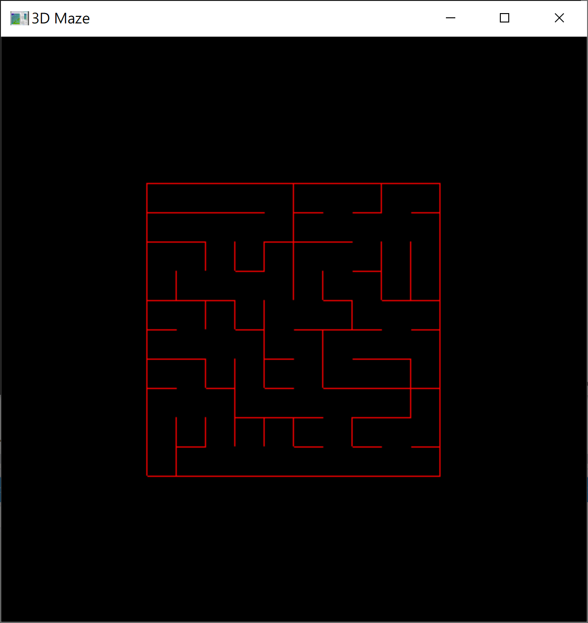
Requirement
3D Maze Construction
consider the 3D space as a rectangular array of cells with four sides.
remove the side until all the cells are connected except from the perimeter

Slide 3
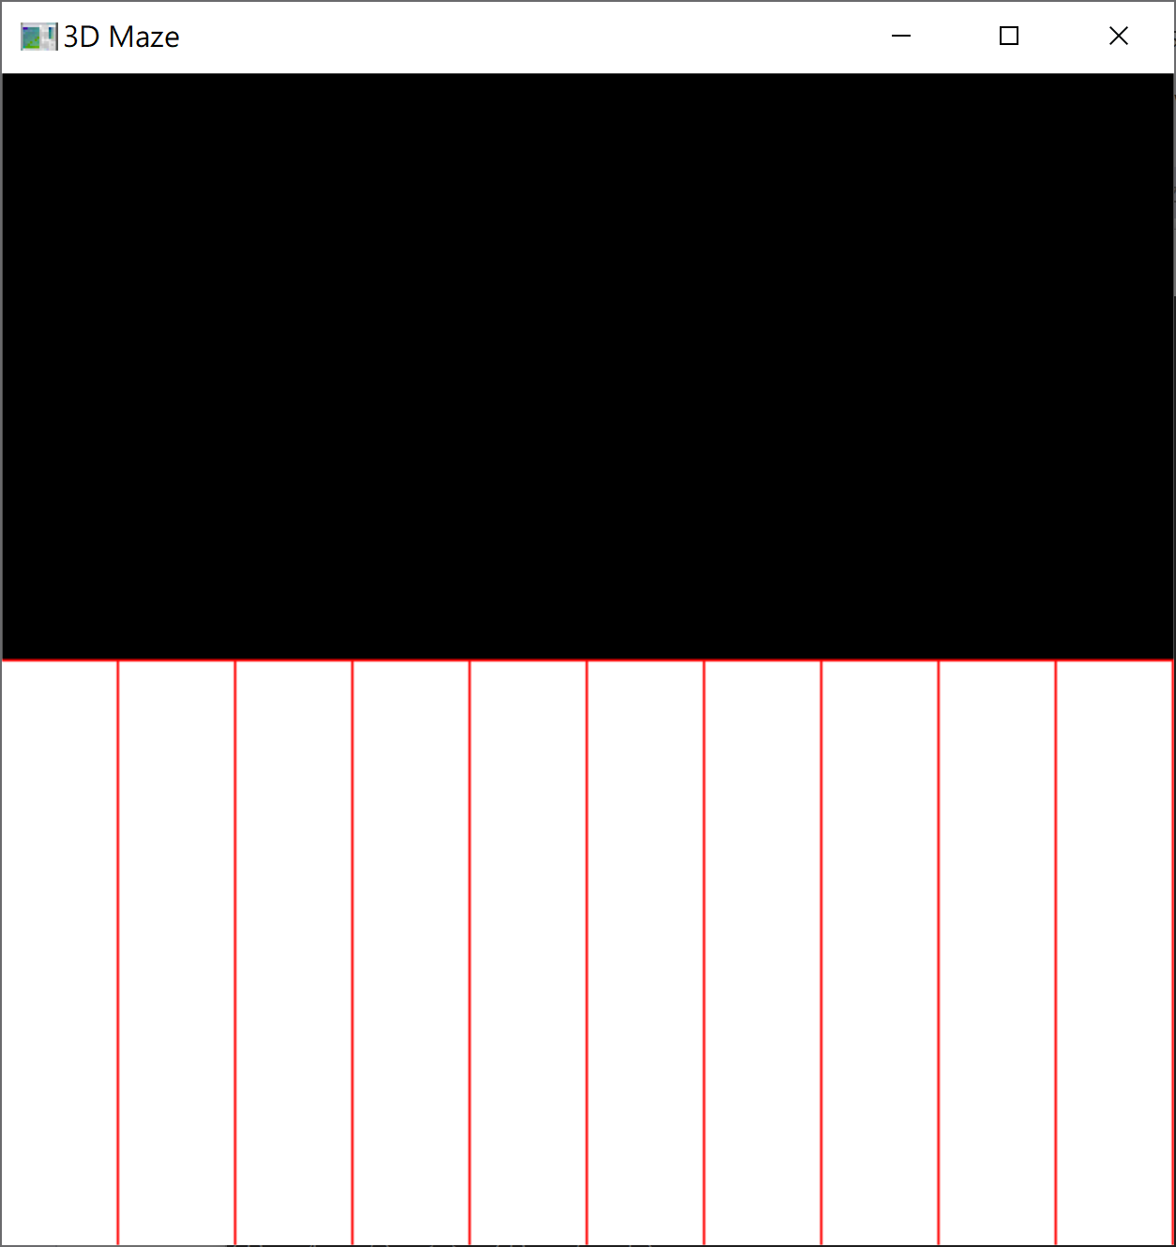
Requirement
3D Maze Viewing
The play can view the 3D maze from the first-person view (key: ‘f’).
To get a hint, the player can view the 3D maze from the bird-eye view (key: ‘b’)..

Slide 4
Requirement
Navigation Control
Initially, the user is located at the center of the top-left cell.
The player uses the mouse to control the user.
Middle Button: move the user forward
Right Button: turn the user 90 degrees to the right
Left Button: turn the user 90 degrees to the left

Slide 5
Coding
Data Definition
#define MAZE_ROWS 10
#define MAZE_COLS 10
int maze[MAZE_ROWS][MAZE_COLS][4];
int view_mode = 0;// 0: side view; 1: bird-eye
// user configurtion
int user_row = 0;
int user_col = 0;
int user_face = 0;

Slide 6
class DisjointSet {
private:
int mi_no_set;// number of sets
int* mpi_parent;// parent array of every item
public:
DisjointSet(int n_item);
public:
int get_no_set(void);// get the number of sets
int find(int);// find the representative
void union_(int, int);// union two sets
};// class DisjointSet

Slide 7
Coding
Initialization
void init() {
init_maze();
glEnable(GL_DEPTH_TEST);
glClearColor(0.0, 0.0, 0.0, 0.0);
}// init() method

Slide 8
void init_maze() {
// create a DisjointSet object
DisjointSet* p_set = new DisjointSet(MAZE_ROWS * MAZE_COLS);
for (int r = 0; r < MAZE_ROWS; r++)
for (int c = 0; c < MAZE_COLS; c++)
for (int s = 0; s < 4; s++)
maze[r][c][s] = 1;
// randomly remove the side until all cells are connected
srand(time(NULL));
while (p_set->get_no_set() != 1) {
…………
}// while-loop
}// init_maze
bool is_found = false;
int cur_row, cur_col, cur_side;
int nei_row, nei_col, nei_side;
while(! is_found){
………
}// while-loop
int x = cur_row * MAZE_COLS + cur_col;
int y = nei_row * MAZE_COLS + nei_col;
if (p_set->find(x) != p_set->find(y)) {
// remove the sides at the two cells
maze[cur_row][cur_col][cur_side] = 0;
maze[nei_row][nei_col][nei_side] = 0;
// union x and y
p_set->union_(x, y);
}// if-condition

Slide 9
bool is_found = false;
int cur_row, cur_col, cur_side;
int nei_row, nei_col, nei_side;
while(! is_found){
………
}// while-loop
int x = cur_row * MAZE_COLS + cur_col;
int y = nei_row * MAZE_COLS + nei_col;
if (p_set->find(x) != p_set->find(y)) {
// remove the sides at the two cells
maze[cur_row][cur_col][cur_side] = 0;
maze[nei_row][nei_col][nei_side] = 0;
// union x and y
p_set->union_(x, y);
}// if-condition
// randomly take an existing side
cur_row = rand() % MAZE_ROWS;
cur_col = rand() % MAZE_COLS;
cur_side = rand() % 4;
if (maze[cur_row][cur_col][cur_side] != 1)
continue;
// write the code to set nei_row, nei_col, // and nei_side by yourself
// check the valid of the neighbor cell
if (nei_row >= 0 && nei_row < MAZE_ROWS &&
nei_col >= 0 && nei_col < MAZE_COLS) {
is_found = true;
}// if-condition

Slide 10
void display() {
glClear(GL_COLOR_BUFFER_BIT|GL_DEPTH_BUFFER_BIT);
glMatrixMode(GL_PROJECTION);
glLoadIdentity();
// set the projection
glMatrixMode(GL_MODELVIEW);
glLoadIdentity();
// draw the eye view
// draw the 3D maze
display_maze();
if (view_mode == 1) {
display_user();
}// if-condition
glFlush();
glutSwapBuffers();
}// display()
switch (view_mode) {
case 0: glOrtho(-1.0, +1.0,
0.0, 10.0,
0.0, 1.0);
break;
case 1: glOrtho(-10.0, +10.0,
-10.0, +10.0,
0.0, 10.0);
break;
}// switch () {
switch (view_mode) {
case 0:
gluLookAt(eye_x, 0.0, eye_z,
at_x, 0.0, at_z,
0.0, 1.0, 0.0);
break;
case 1: gluLookAt(0.0, 10.0, 0.0,
0.0, 0.0, 0.0,
0.0, 0.0, -1.0);
break;
}// switch () {

Slide 11
void display_maze() {
glPushMatrix();
glTranslatef(-5.0, 0.0, -5.0);
for (int r = 0; r < MAZE_ROWS; r++)
for (int c = 0; c < MAZE_COLS; c++)
for (int s = 0; s < 4; s++) {
glPushMatrix();
glTranslatef((float)c * 1.0 + 0.5, 0.0,
(float)r * 1.0 + 0.5);
glRotatef((float)s * 90, 0.0, 1.0, 0.0);
if (maze[r][c][s] == 1) {
display_side();
}// if-condition
glPopMatrix();
}// for-loop
glPopMatrix();
}// display_maze()

Slide 12
void display_user() {
glPushMatrix();
glTranslatef( (float)user_col * 1.0 + 0.5 - 5.0, 0.0, (float)user_row * 1.0 + 0.5 - 5.0);
glRotatef((float)user_face * 90, 0.0, 1.0, 0.0);
glColor3f(1.0, 1.0, 1.0);
glBegin(GL_POLYGON);
…….
glEnd();
glColor3f(0.0, 1.0, 0.0);
glBegin(GL_LINES);
glVertex3f(0.0, 5.0, 0.0);
glVertex3f(+0.5, 5.0, 0.0);
glEnd();
glPopMatrix();
}// display_user()
glVertex3f(+0.1, 5.0, +0.1);
glVertex3f(+0.1, 5.0, -0.1);
glVertex3f(-0.1, 5.0, -0.1);
glVertex3f(-0.1, 5.0, +0.1);

Slide 13
Coding
Keyboard Callback
void keyboard(unsigned char key, int x, int y) {
if (key == 'q' || key == 'Q') {
exit(0);
}else if (key == 'f' || key == 'F') {
view_mode = 0;
glutPostRedisplay();
}else if (key == 'b' || key == 'B') {
view_mode = 1;
glutPostRedisplay();
}// if-else condition
}// End of keyboard

Slide 14
void mouse(GLint button, GLint state, GLint x, GLint y) {
if (button == GLUT_RIGHT_BUTTON
&& state == GLUT_DOWN) {
user_face = (user_face + 1) % 4;
}else if (button == GLUT_LEFT_BUTTON
&& state == GLUT_DOWN){
user_face = user_face - 1;
if (user_face < 0)
user_face = 3;
}else if (button == GLUT_MIDDLE_BUTTON
&& state == GLUT_DOWN){
// move forward
switch (user_face) {
………
}// switch
}// if-else
glutPostRedisplay();
}// mouse()

